Slide 1
GA Project 1 - SAT & ACT Analysis
Analysis of SAT and ACT Participation Rates and scores for 2017 and 2018

Slide 2
Goal : To analyze and Increase participation rates for SAT and ACT

Slide 3
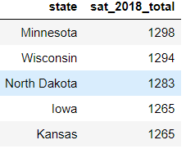
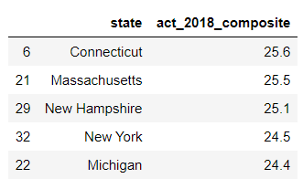
States with Top Participation Rates
SAT 2018 Highest Total Scores
ACT 2018 Highest Total Composite scores

Slide 4
Observations on Rate Changes 2017-2018
Colorado had 100% participation at 2017 and 30% at 2018
The data suggest that the majority of students have shifted from taking ACT at 2017 to taking SAT at 2018, as the SAT participation rate have increased significantly
Participation rates in Florida in both SAT and ACT have reduced in 2018, compared to 2017.

Slide 5
Distribution of Participation Rates
In overall, participation rates generally do not follow a normal distribution for ACT and SAT

Slide 6
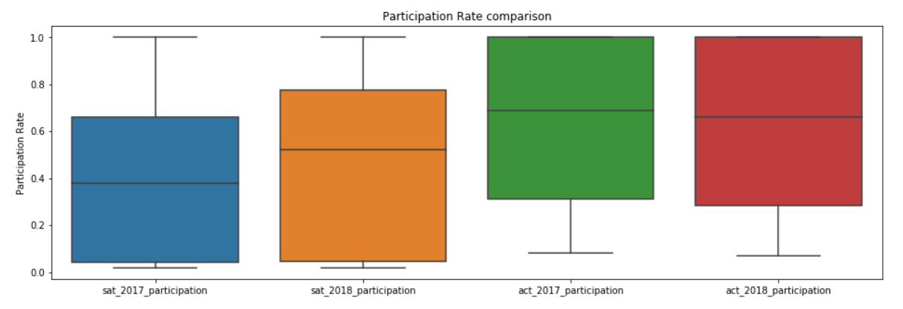
Trends
From 2017-2018, SAT participation rates have increased, while ACT participation rates
Have decreased.

Slide 7
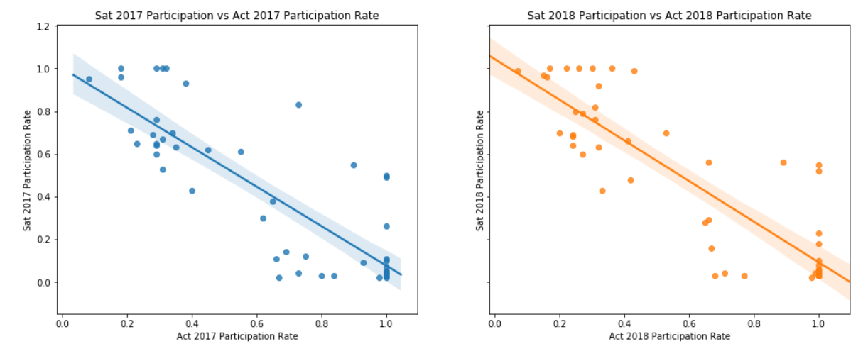
SAT VS ACT Participation rates
Generally, there is a a negative correlation between participation rates of both tests within
The same state. This suggest that students typically have a higher tendency to select only 1 test

Slide 8
Ways to increase participation Rates
Ways to increase participation Rates
Make the test mandatory for all high school students, which is done by Colorado and Illinois that have increased their participation rates from 11% and 9% to 100% and 99% respectively at 2018.
The college board can vote to make SAT / ACT a mandatory for college admissions
A less intrusive way would be to get colleges and universities to explicitly accept SAT scores during admission

